Slide 1
Quality Code, Optimization, and Problem Solving
Code Camp Week 6

Slide 2
Readability
The level to which a person can read and understand code that they did not write

Slide 3
Why is readable code important?
Working on code with a coworker
Finishing a project with a partner
Reading documentation about an API
Understanding standard library functions
All of these situations require readable code…

Slide 4
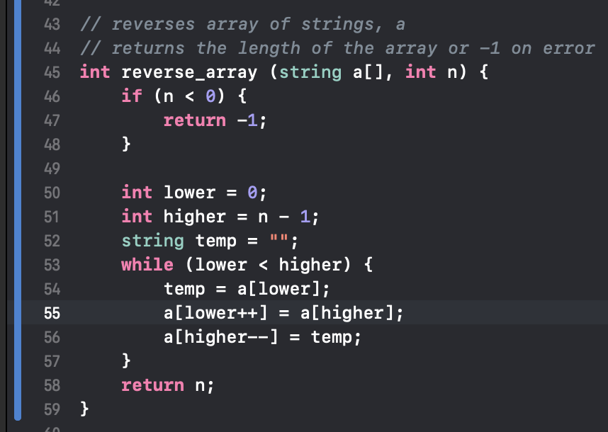
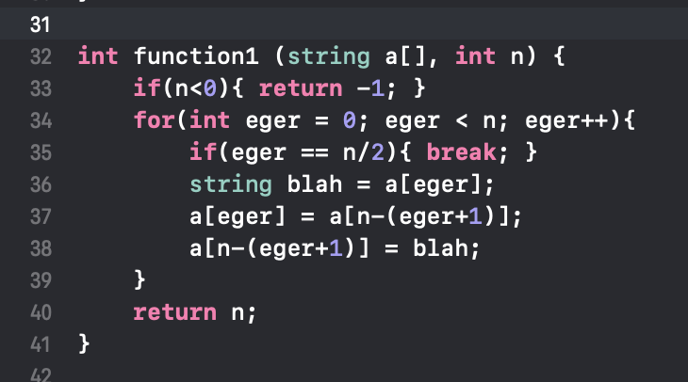
Hall of Shame vs. Fame
Notes:
Clear indentations
Comments
No weird names
Using a while loop instead of for loop increases clarity
No one line checking

Slide 5
Tips for Improving Readability
Choose variable and function names that describe them
Ex. int counter = 0, reverse_string(), find_maximum(), sort()
Use indentation and spacing properly
Utilize comments when needed
Write a README

Slide 6
Optimization Tips
Don’t worry in CS 31, but it’s never too early to think about it
Most optimization happens in your choice of algorithm
E.g. In a set of integers find a grouping of 3 integers which maximizes the sum of the 3 integers
Roughly speaking, the following is true:
Using operations (+, -, comparisons) increases your time complexity
Using variables increases what is called space complexity

Slide 7
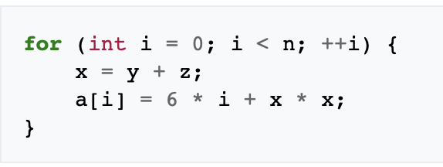
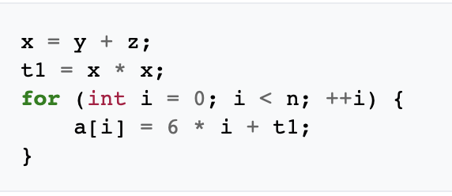
Code Motion
Moving code around to (hopefully) improve performance

Slide 8
In-Place Manipulation
Doing things like string reversals, or list rotating can be done in-place and utilize much less memory when doing so

Slide 9
A Note Regarding Optimization
Don’t worry about in CS 31
In general, don’t worry about it too much unless it’s a problem
E.g. something is taking too long, using too much memory, etc.
That being said, optimizing as you go is good because you can avoid the problem of going back as long as possible
DO NOT attempt to optimize without profiling

Slide 10
What is profiling?
Method of determining which parts of your code are utilizing the most resources
Can help you identify performance bottlenecks
This is where you should seek to optimize

Slide 11
Real-World Practice Problem #1
Write a function which can verify the solution to a Sudoku puzzle

Slide 12
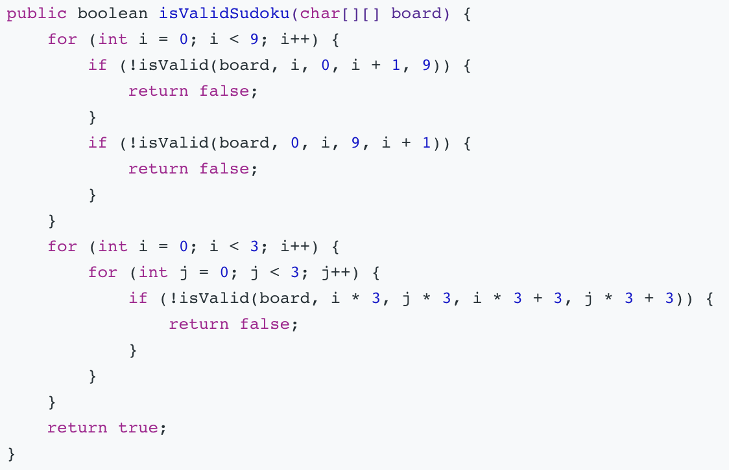
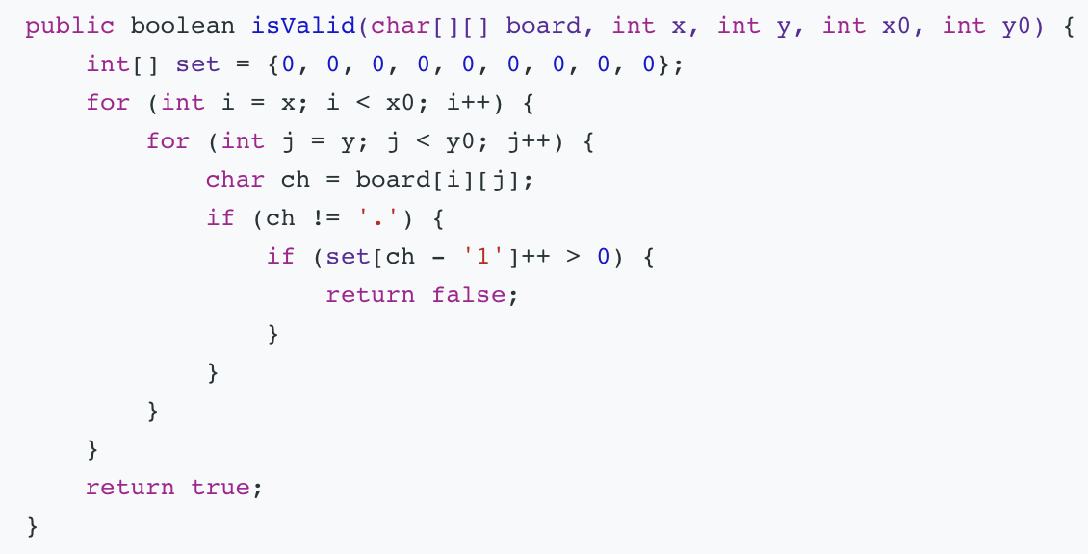
Real-World Practice Solution #1
Write a function which can verify the solution to a Sudoku puzzle

Slide 13
Real-World Practice Problem #2
Suppose we have a high speed online game that people are constantly checking in at. We want to be able to understand the age makeup of these people. Design a function with the following specification:
Given: An array of 1000 integers representing the ages of 1000 players
Provide: The number of players of each age.

